Slide 1

Final Presentation on Futsal Management System
Presented by:
Ujan Manandhar
Rohit Prasain
Ravi Gurung

Slide 2
Acknowledgement
We would like to thank NCCS college and mentors for making this project happen.

Slide 3
Product Information
This management system is a desktop application program.
This system is used to book futsal ground.
Our project’s objective is to reduce booking time duplication.

Slide 4
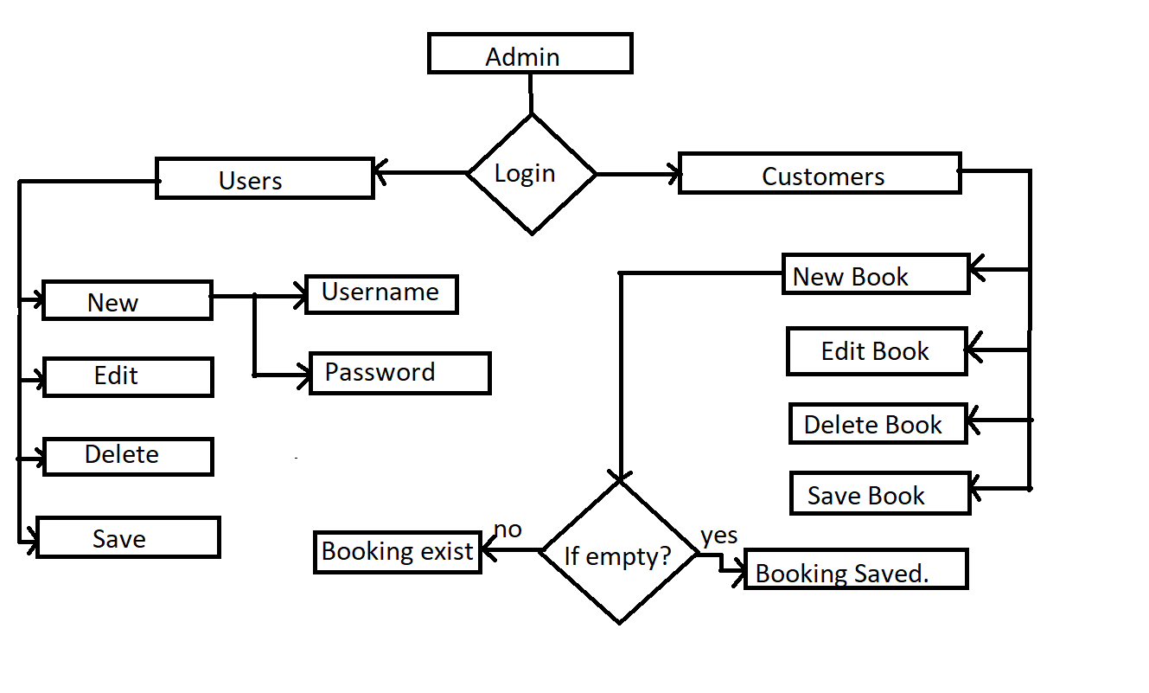
Workflow
This software is only for admin of futsal.

Slide 5
Problem Statement
The suggestions to this project were:
UI improvements
Calendar view to pick date and time
Empty time slots recommendation

Slide 6
Task Worked On
We have designed better UI.
Added calendar view
Maintained form validation in the login page.

Slide 7
Define Process
Improved UI using designing tools.
We used jCalendar for adding the calendar view to store date in db.
Used jSpinner for time view.

Slide 8
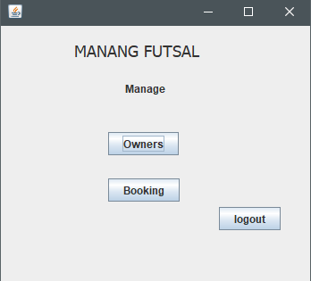
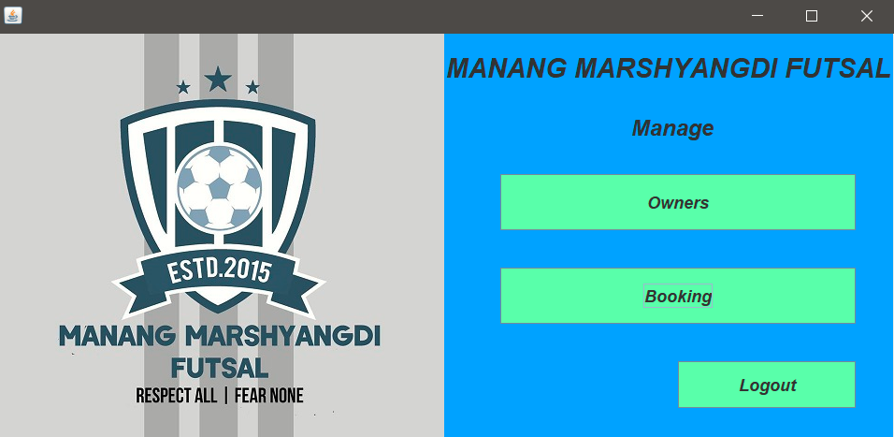
Improvement of UI interface
Previous UI Current UI

Slide 9
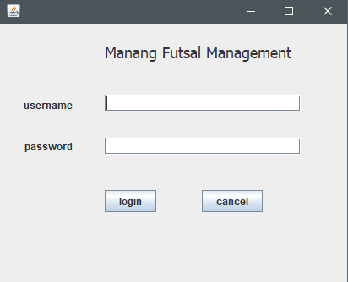
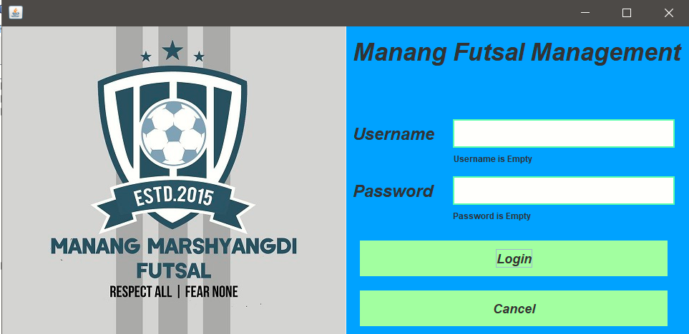
Form Validation in Login screen
Without Form Validation With Form Validation

Slide 10
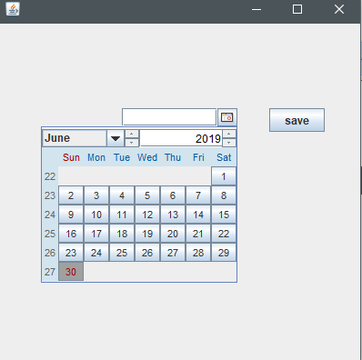
Implementation of calender

Slide 11
Challenges
Time slot recommendation view was not completed
Unable to link jSpinner value in db for entering time

Slide 12
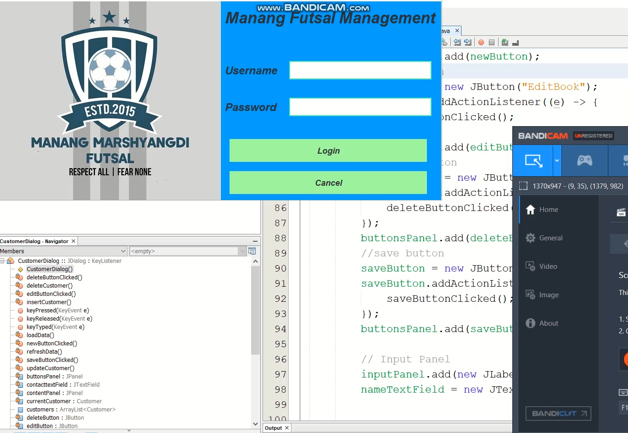
Demo

Slide 13
Thank You !!!

